Slide 1
Database integrity and constraints Dr Mariana Rocha School of Computer Science
CMPU 2007 Databases 1, Lecture 3

Slide 2
Databases integrity
So far, we have learned how to build and populate tables considering two main types of constraints: key constraints and data type constraints.
Today, we will expand on and examine other aspects of relational databases that can help keep our data safe and easy to access.

Slide 3
Constraints
Constraints are rules that the data must follow to be included in or excluded from a given entity.
Ensures that whoever uses your data can be confident that the data will be consistent.

Slide 4
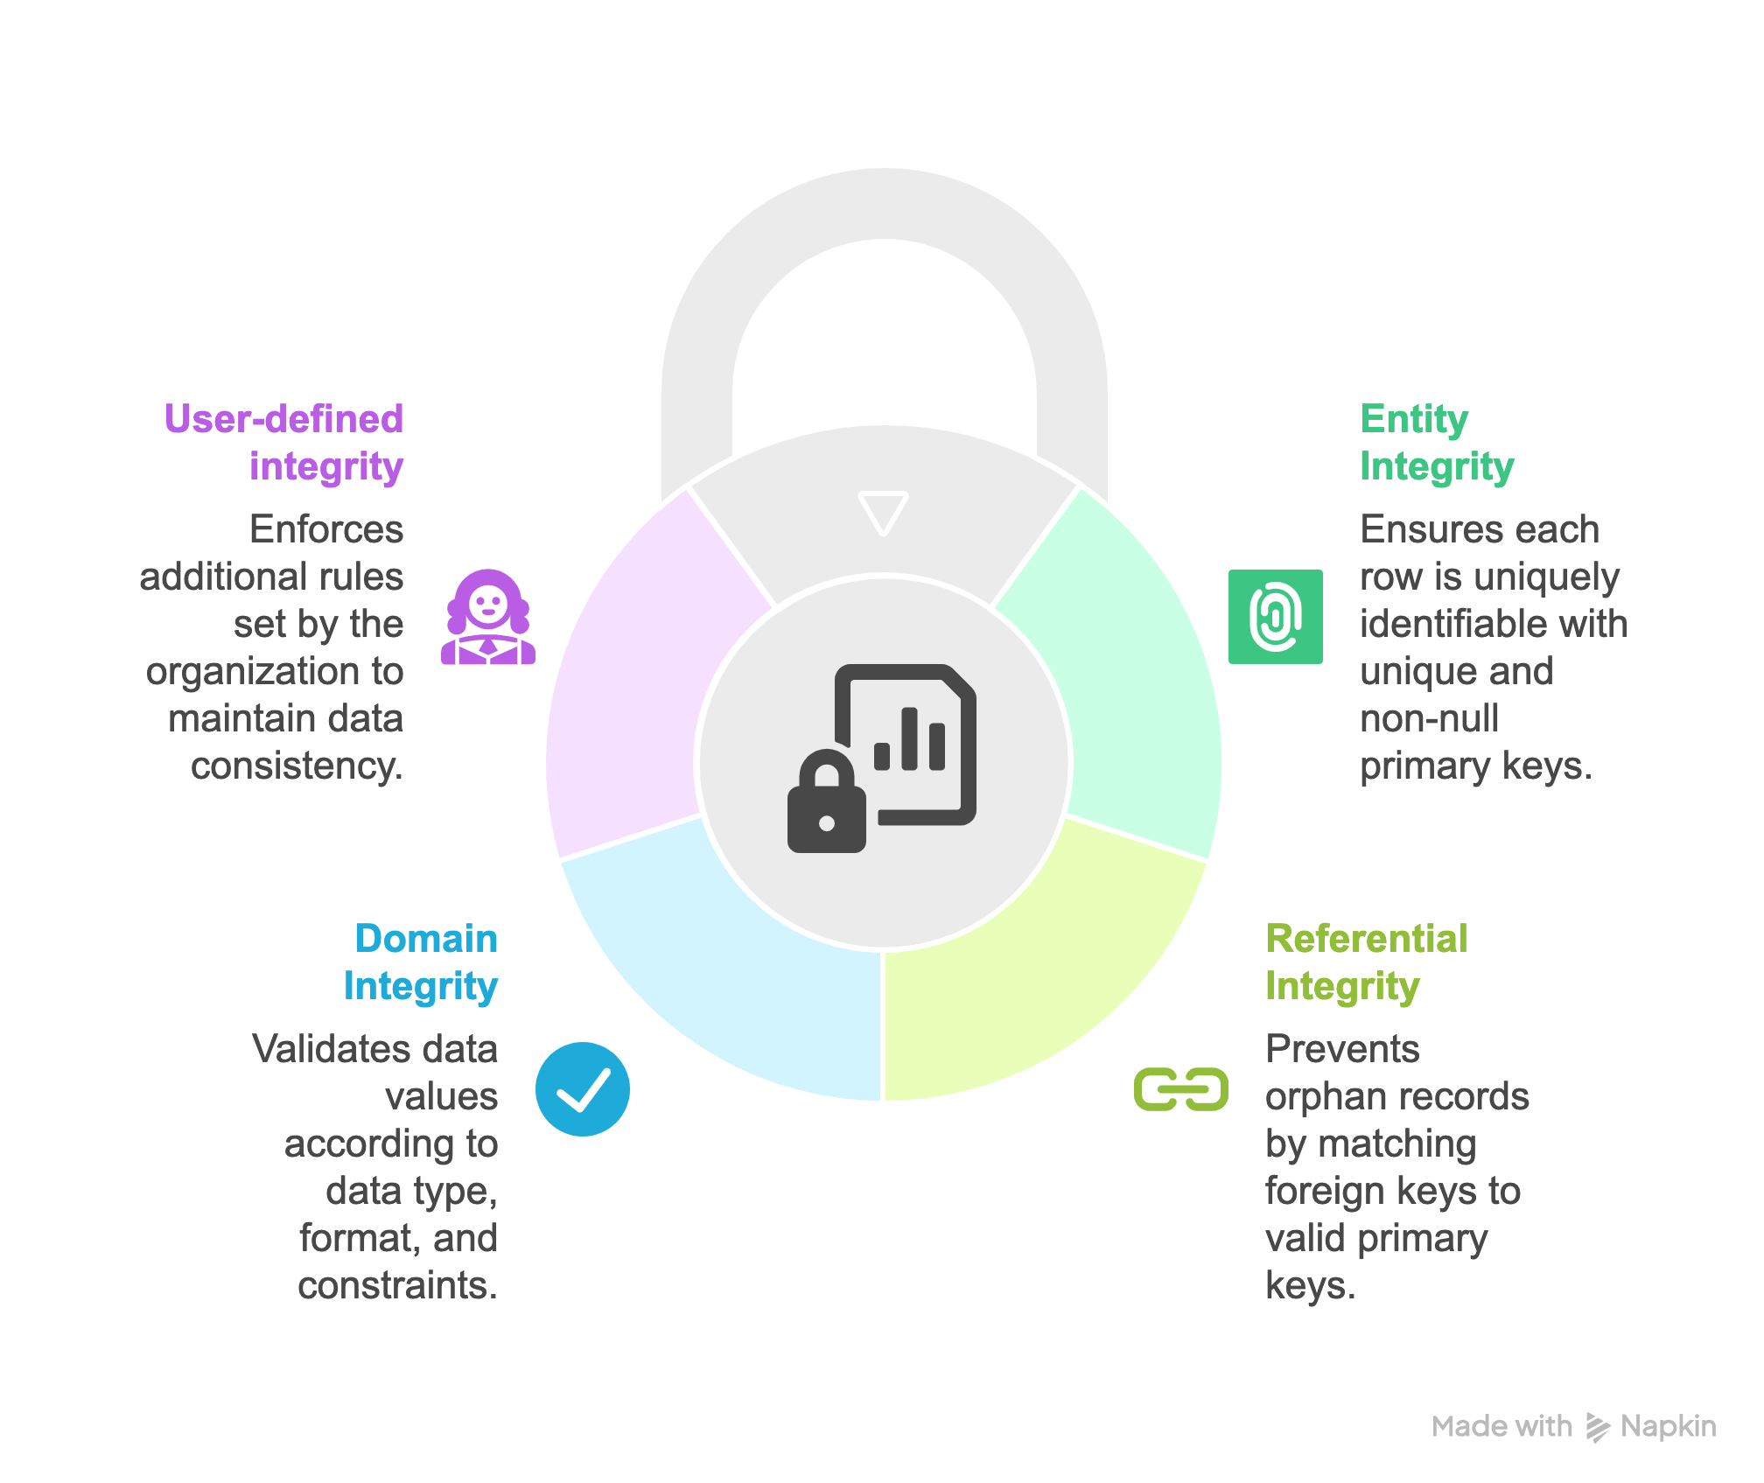
Databases integrity

Slide 5
Entity integrity

Slide 6
Entity integrity
Entity integrity: Every table must have a primary key, and its values must be unique, not null and cannot change. This ensures each row is identifiable.
CREATE TABLE clubs (
club_id TEXT PRIMARY KEY, -- club id must be unique, not null and cannot change
club_name VARCHAR(120) UNIQUE NOT NULL);

Slide 7
Referential integrity

Slide 8
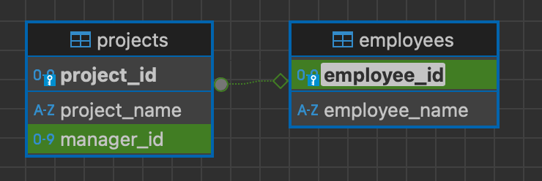
Foreign Keys can be NULL sometimes
In this example, manager_id is a FK coming from the table employees.
A project can exist without a manager assigned to it, so the record of the manager_id (foreign key) would be null.

Slide 9
Foreign Key - Syntax
FOREIGN KEY: Defines the column in the child table at the table- constraint level
REFERENCES: Identifies the table and column in the parent table
Additional things you can add to the constraint:
ON DELETE CASCADE: Deletes the dependent rows in the child table when a row in the parent table is deleted
ON DELETE SET NULL: Converts dependent foreign key values to null

Slide 10
-- Create the Employees table (parent table)
CREATE TABLE Employees (
employee_id INT PRIMARY KEY,
employee_name VARCHAR(100)
);
-- Create the Projects table (child table)
-- We have two options of foreign key constraints:
-- 1. ON DELETE CASCADE: If an employee is deleted, the associated project will also be deleted.
-- 2. ON DELETE SET NULL: If an employee is deleted, the manager_id of the associated project will be set to NULL.
CREATE table Projects (
project_id INT PRIMARY KEY,
project_name VARCHAR(100),
manager_id INT,
FOREIGN KEY (manager_id) REFERENCES Employees(employee_id) ON DELETE SET NULL
);

Slide 11
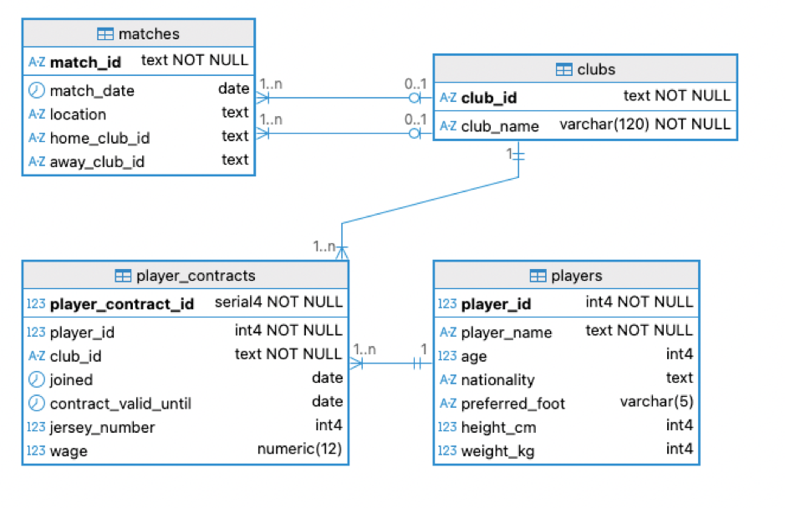
Cascade and Referential Integrity

Slide 12
DROP TABLE CASCADE
CASCADE is an option you can set on foreign keys or DROP TABLE statements. You are telling the system that, if the parent table changes or is deleted, the same applies to the child tables.
Considering our football database:
DROP TABLE players CASCADE;
Will drop the foreign key constraint in the table player_contracts. The values for player_id and club_id in the table persist, but only club_id is still considered a foreign key.

Slide 13
ON DELETE CASCADE
CREATE TABLE player_contracts (
player_contract_id SERIAL PRIMARY KEY,
player_id INT REFERENCES players(player_id) ON DELETE CASCADE,
club_id TEXT REFERENCES clubs(club_id),
joined DATE,
contract_valid_until INT,
jersey_number INT,
wage NUMERIC(12,0)
);
If we run:
The entire row in player_contracts where player_id = 101 will be deleted.
The foreign key still exists, but the original player is gone, so all contracts for that player should also be gone.
DELETE FROM players WHERE player_id = 101;

Slide 14
ON UPDATE CASCADE
CREATE TABLE matches (
match_id TEXT PRIMARY KEY,
match_date DATE,
location TEXT,
home_club_id TEXT REFERENCES clubs(club_id) ON UPDATE CASCADE,
away_club_id TEXT REFERENCES clubs(club_id) ON UPDATE CASCADE
);
Suppose we added a club named “FC Barcelona” to the table clubs. If we run:
The clubs table now has 'BARCA' instead of ‘FC Barcelona'.
Because of ON UPDATE CASCADE, the matches.home_club_name is automatically updated to 'BARCA'.
No manual fix is needed.
UPDATE clubs SET club_name = 'BARCA’ WHERE club_name = ‘FC Barcelona';

Slide 15
When to use CASCADE
ON DELETE CASCADE
Use when the child record only makes sense when the parent exists.
ON UPDATE CASCADE
Use if the parent key values might change and children should follow.

Slide 16
When not to use CASCADE
When NOT to use CASCADE:
Data should be preserved for history
Considering player_contracts: if a club is deleted, should all contracts vanish? Maybe contracts might need to be preserved for history.
Auditing/legal reasons.
You might want to prevent deleting a club if contracts exist → use ON DELETE RESTRICT instead.
DROP TABLE CASCADE: Useful in development/testing when you want to remove everything quickly. It is, though, dangerous in production — it removes dependent objects automatically, which may not be what you want. Avoid using DROP TABLE CASCADE.

Slide 17
Domain integrity

Slide 18
Domain integrity
Define that values must obey rules for data type, format and acceptable range.
Includes use of commands such as NOT NULL, UNIQUE, CHECK, LIKE, and DEFAULT..

Slide 19
NULL and NOT NULL
What is NULL?
Null is a non-value
It is not zero
It is not blank
NULL is a special name to denote a valueless column in a row.
If the column must contain a non-null value, the constraint ‘NOT NULL’ should be put on it.
This will prevent a user from adding a row that has no value for this column. For example, there is no sense in adding a student without a name. There is no sense in adding a stock item without a description.
The default is NULL
Unless you specify NOT NULL, nulls will be allowed.

Slide 20
NOT NULL
CREATE TABLE players (
player_id INT PRIMARY KEY,
player_name TEXT NOT NULL, -- must always have a name
age INT,
nationality TEXT,
preferred_foot TEXT,
body_type TEXT,
height TEXT,
weight TEXT
);

Slide 21
DEFAULT
Provides an automatic value for a column if no value is supplied during an INSERT.
Suppose when a new contract is created, if no wage is specified, it should default to 0.
If a wage is specified, its value overrides the 0.
CREATE TABLE player_contracts (
player_contract_id SERIAL PRIMARY KEY,
player_id INT REFERENCES players(player_id),
club_id TEXT REFERENCES clubs(club_id),
joined DATE DEFAULT CURRENT_DATE,
contract_valid_until INT,
jersey_number INT,
value NUMERIC(12,0) DEFAULT 0,
wage INT DEFAULT 0,
release_clause INT
);

Slide 22
UNIQUE
This allows the column value to be checked against all other values in that column in the table.
This constraint can be applied even if the column allows null values.
For example, an e-mail address is not necessary, but if it is present, it must be unique: no other member can have the same e-mail address.
CREATE TABLE clubs (
club_id TEXT PRIMARY KEY,
club_name VARCHAR(120) UNIQUE NOT NULL -- club names must be unique
);

Slide 23
CHECK
Defines a condition that each row must satisfy
This allows the column value to be checked
against a range of values
E.g. < value, > value, between n and m, etc.
or selection of values.
E.g. IN (‘Monday’,’Tuesday’,’Wednesday’)
A single column can have multiple CHECK constraints that refer to the column in its definition.

Slide 24
CHECK
CREATE TABLE players (
player_id INT PRIMARY KEY,
player_name TEXT NOT NULL,
age INT CHECK (age >= 16) CHECK (age > 0) – two checks
);

Slide 25
BETWEEN conditions
Use the BETWEEN condition to restrict values to a particular range
ALTER TABLE players
ADD CONSTRAINT age_range CHECK (age BETWEEN 16 AND 50);
The BETWEEN operator works like any other comparison (e.g., >, <, =), but it needs to be part of a CHECK constraint for it to have an effect.

Slide 26
IN operator
Use the IN membership condition to test for values in a list
CREATE TABLE players (
player_id INT PRIMARY KEY,
player_name TEXT NOT NULL,
age INT CHECK (age BETWEEN 16 AND 50),
nationality TEXT,
preferred_foot TEXT CHECK (preferred_foot IN ('Left','Right','Both')));

Slide 27
LIKE operator
Use the LIKE condition to pattern match valid string values.
Conditions can contain either literal characters or numbers:
% denotes zero or many characters.
_ denotes one character.
CREATE TABLE clubs (
club_id TEXT PRIMARY KEY CHECK (club_id LIKE 'CLB-%'), -- must start with CLB-
club_name VARCHAR(120) UNIQUE NOT NULL
);

Slide 28
User-defined integrity (Business rules)

Slide 29
User-defined
They are part of domain constraints, but can be decided based on the business logic, not general logic.
For example, the club managers could decide that player_contract should have a release_clause, and this column should have values at least twice the wage.
That prevents players from being bought too cheaply.
CREATE TABLE player_contracts (
player_contract_id SERIAL PRIMARY KEY,
player_id INT NOT NULL,
club_id TEXT,
wage INT NOT NULL CHECK (wage >= 0),
release_clause INT CHECK (release_clause >= 2 * wage)
);

Slide 30


